Slide 1
University of Padua – Department of Information Engineering Bachelor’s Degree in Control System Engineering
Embedded Real-Time Control Laboratory Activities and Key Concepts
Group 4:
Brescia Davide (2182457)
Favaro Manuel (2199436)
Filannino Daniele (2179425)
Padua, 19/02/2026

Slide 2

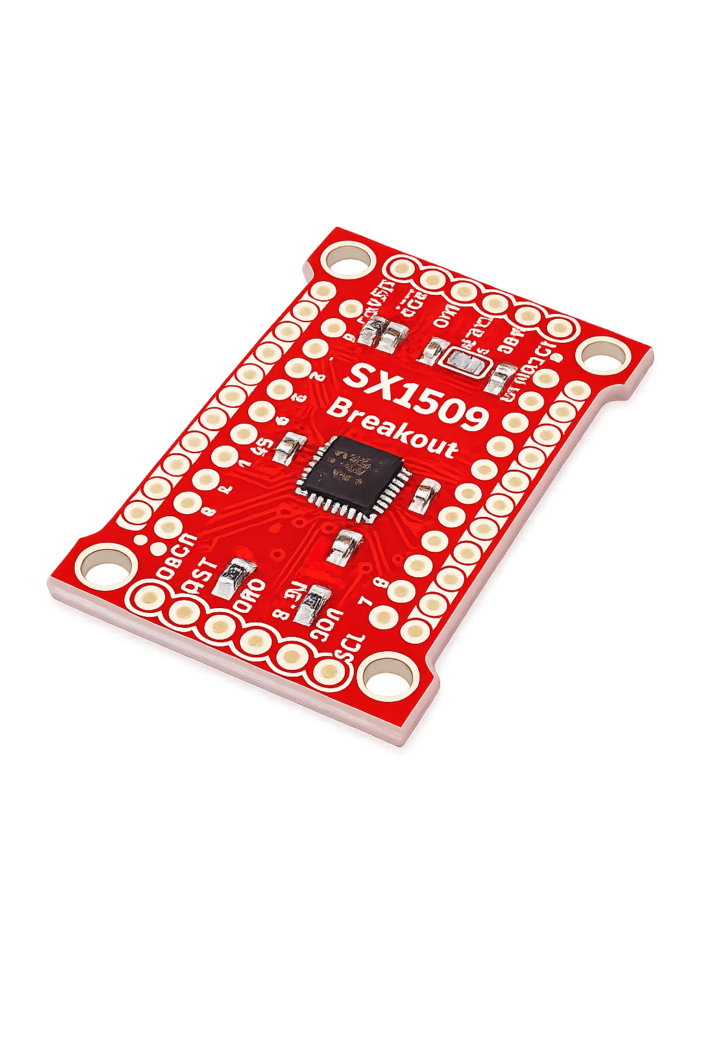
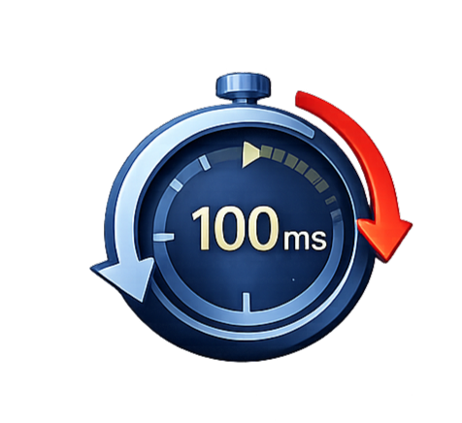
LABORATORY 1
Configure and handle external interrupts;
Data acquisition from keypad and line sensor via I2C
Periodic line sensor reading using both polling
HAL_GetTick()
Hardware Timer Interrupt

Slide 3
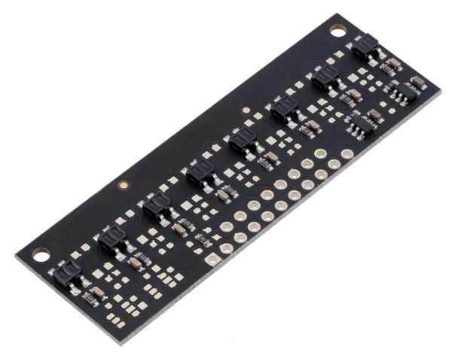
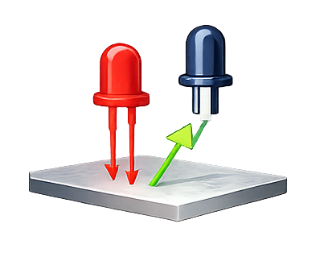
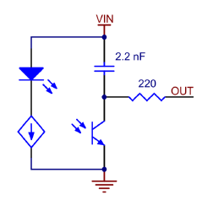
LINE SENSOR
Infrared line sensor Pololu QTR-MD-08RC
Integrated infrared LEDs and phototransistors
Communicates via I2C bus

Slide 4
Periodic Polling Approaches
Busy-Waiting Polling
Non-blocking Polling
Timer-Based Polling
Continuous polling
Simple but inefficient
CPU fully occupied
HAL_GetTick() as a software timer
Improved efficiency
CPU not blocked
Based on time comparison
Hardware timer every 100ms
Precise and reliable timing
CPU not blocked
Interrupt Service Routine ISR

Slide 5
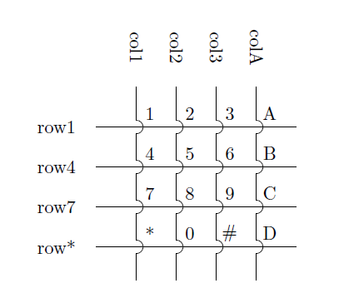
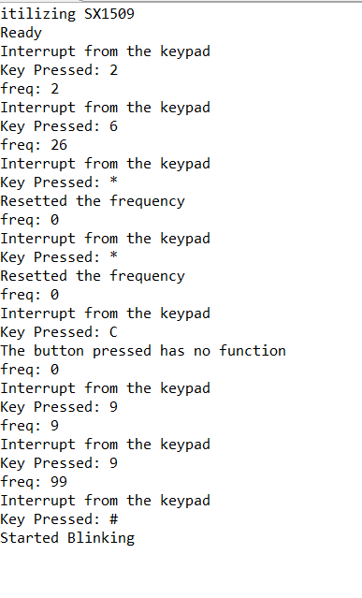
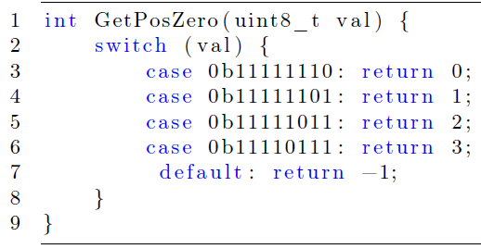
KEYPAD SETUP
Numeric key (’0’–’9’)
Clear key (’*’)
Confirmation key (’#’)
Other keys (e.g., A, B, C, D)

Slide 6
BLINK() FUNCTION
Blocking Approach
Non-blocking Approach
Uses hardware timer with periodic callback
Software based counter
LED can blink without blocking CPU
Uses HAL_Delay()
Divison by zero check (freq = 0)
CPU blocked inside delay loop

Slide 7

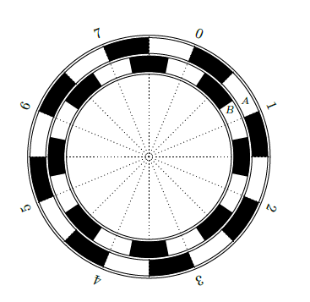

LABORATORY 2
Open-loop motor actuation using PWM signals
Angular speed measurement using incremental encoders
Data acquisition for motor model identification

Slide 8
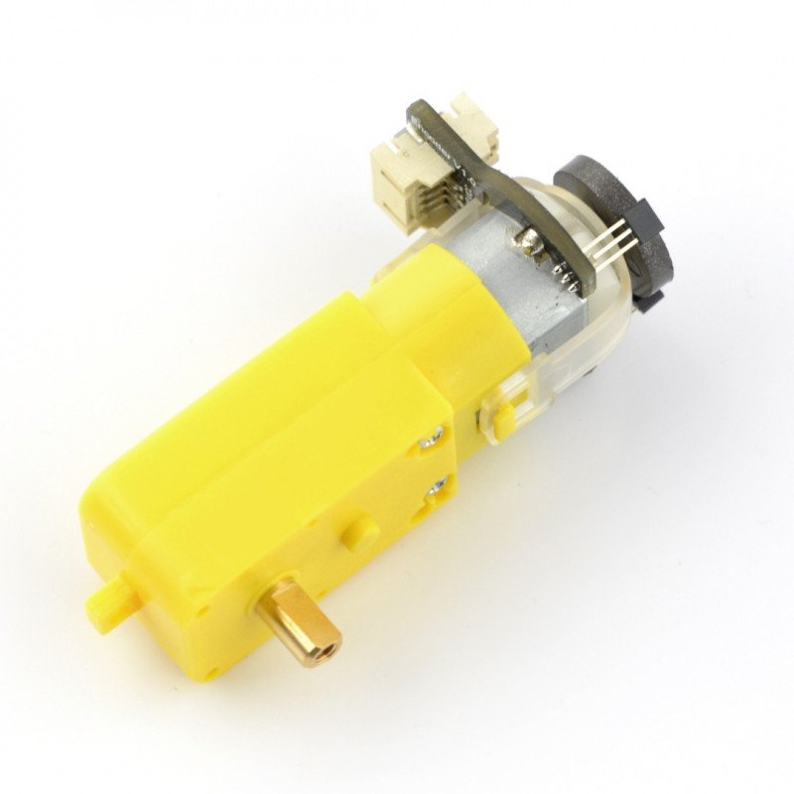
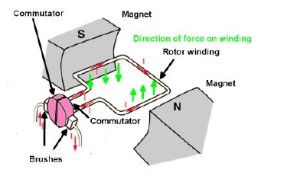
MOTORS
Forward
Reverse
Brake
Coast
Forward and Coast: the PWM alternates between forward drive and coast mode
Forward and Brake: the PWM alternates between forward drive and active braking

Slide 9
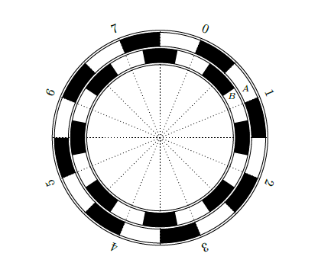
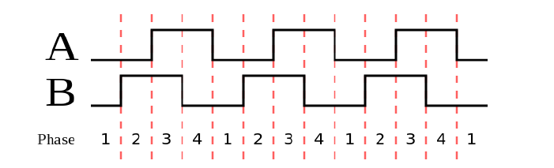
ENCODERS
Data analysis performed in MATLAB:
Motors angular velocities (in rad/s)
Reference voltage (step input)

Slide 10
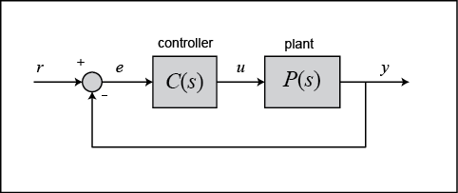
Second Part – Motor Control
Identifying working points
Motor Parameters Estimation
PI Controller Design
Validation of Controllers
Windup Problem

Slide 11
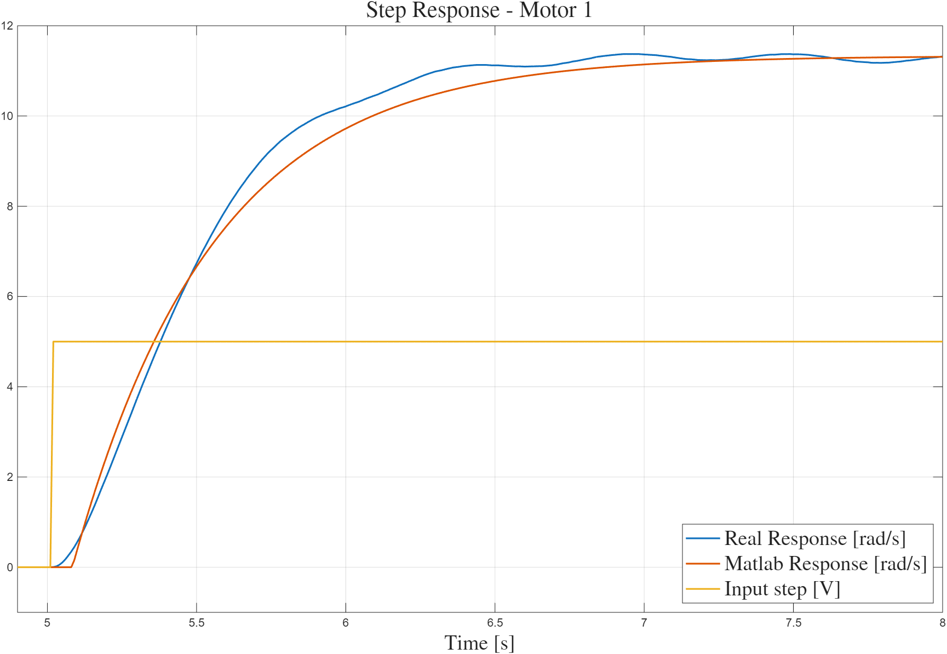
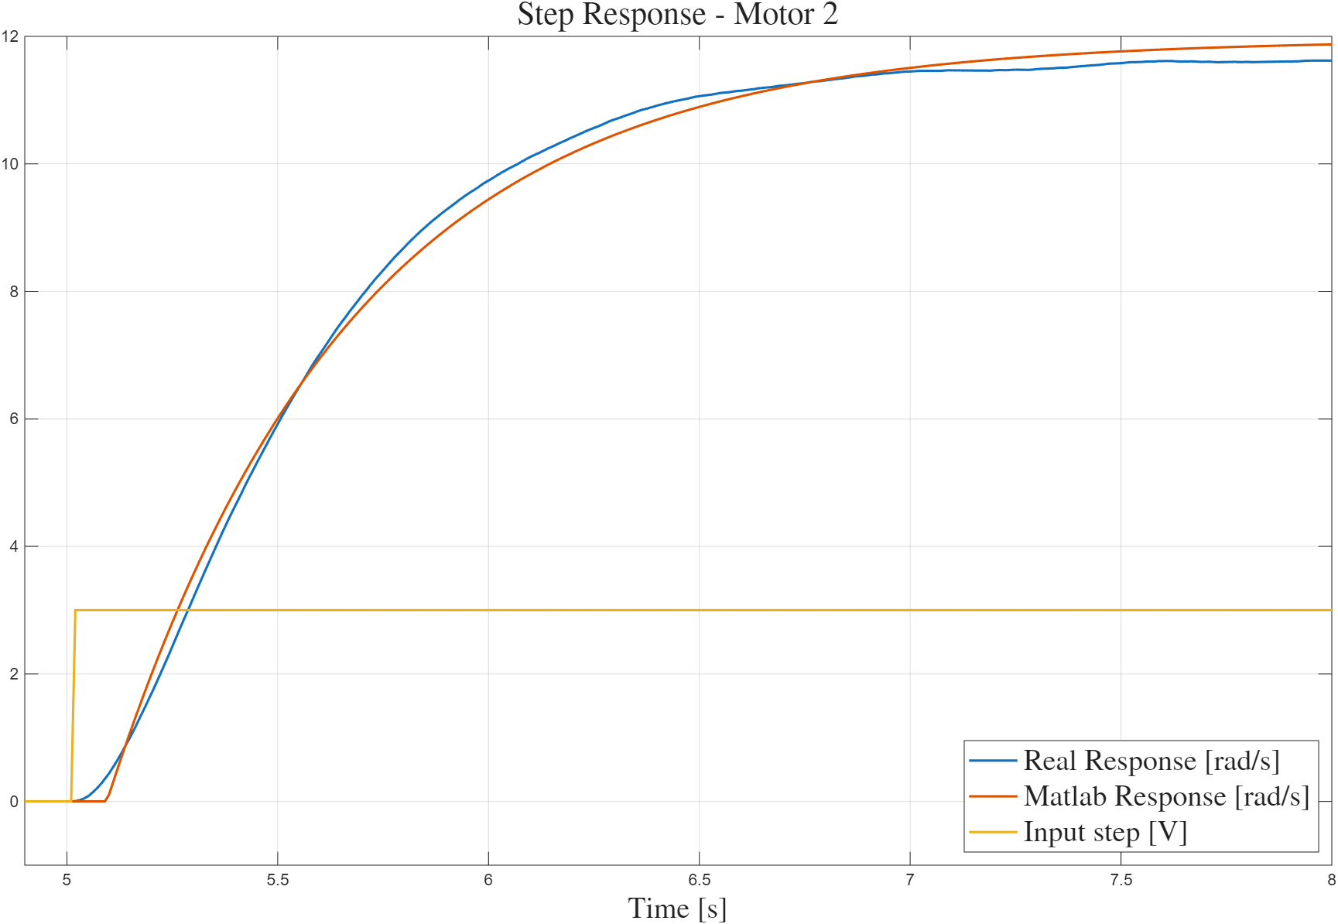
Working Points Identification
First ISSUE
Real-World non linearities
Behaviour of Left Motor
Behaviour of Right Motor

Slide 12
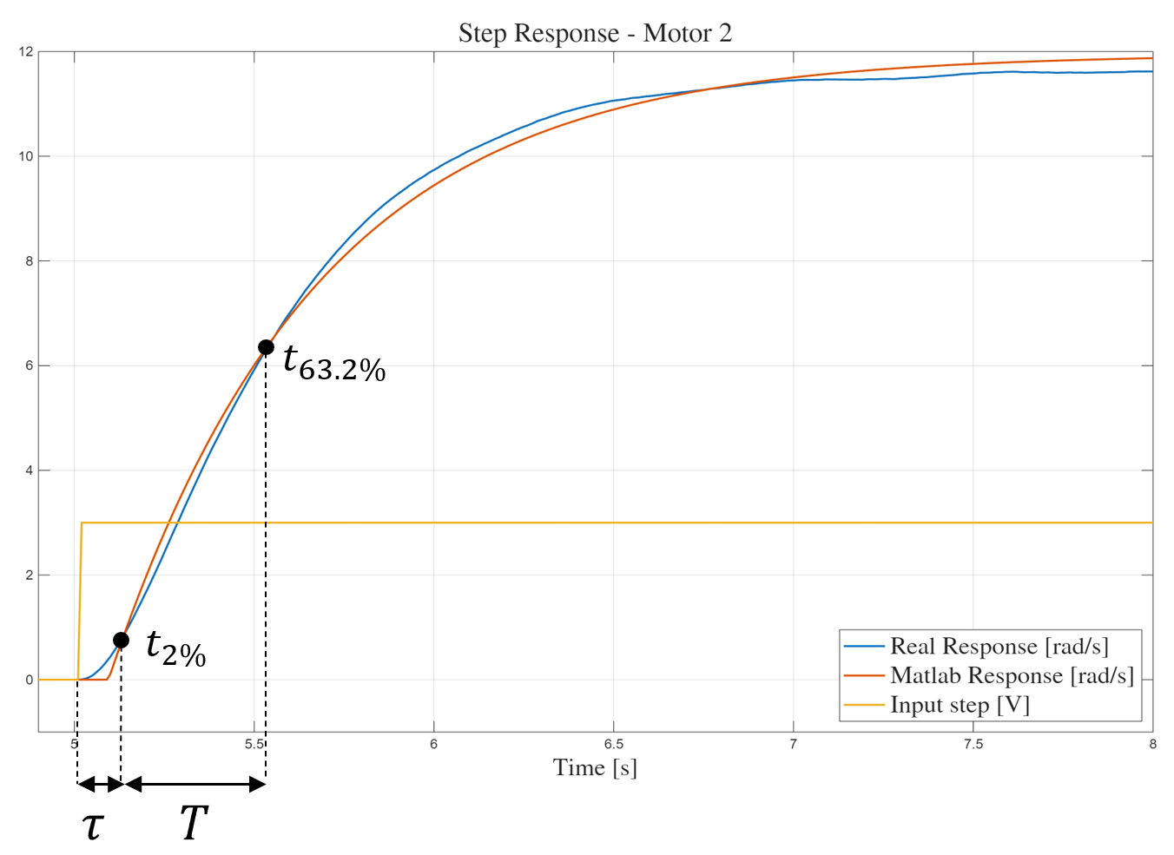

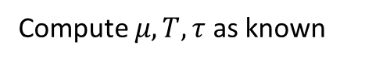
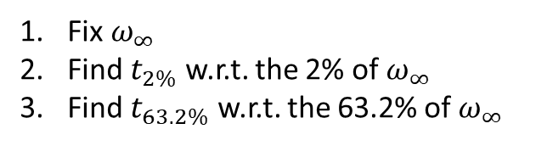
Motor Parameters Estimation – Graphical Method
First Rough Estimate
(Baseline)
Fix $ω_{∞}$
Find $t_{2\%}$ w.r.t. the 2% of $ω_{∞}$
Find $t_{63.2\%}$ w.r.t. the 63.2% of $ω_{∞}$
Repeat with different $V_{in}$
Compute $μ, T, τ$ as known

Slide 13
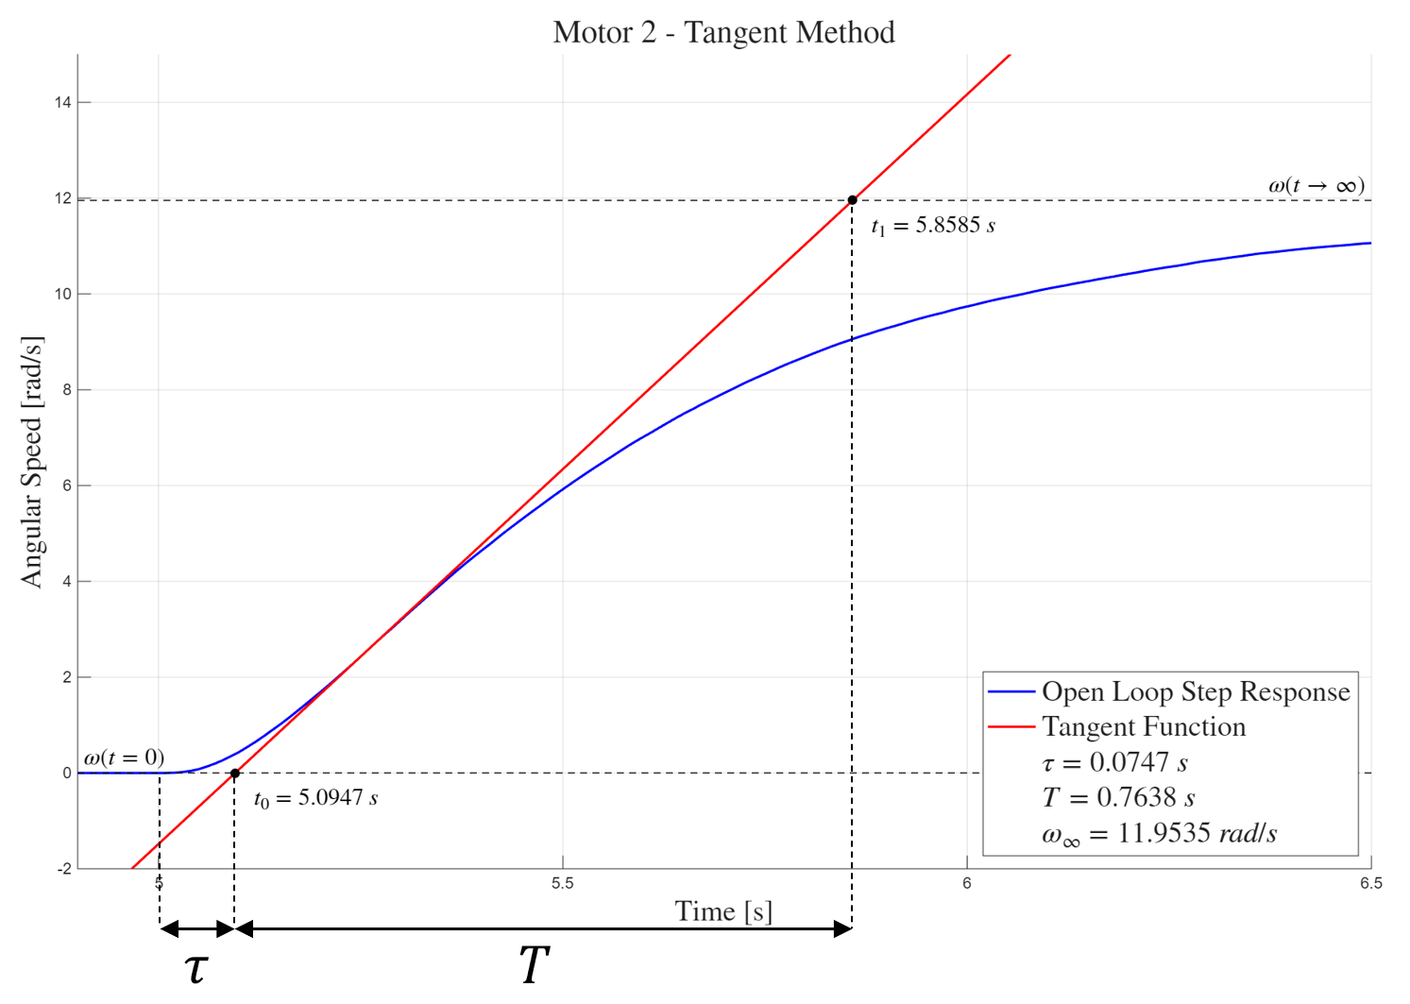


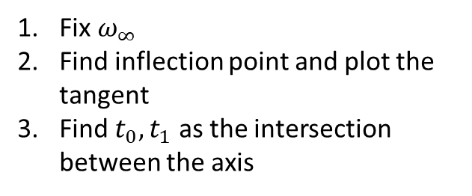
Motor Parameters Estimation – Tangent Method
Deterministic and more precise
Fix $ω_{∞}$
Find inflection point and plot the tangent
Find $t_{0}, t_{1}$ as the intersection between the axis
Repeat with different $V_{in}$
Compute $μ, T, τ$ as known

Slide 14
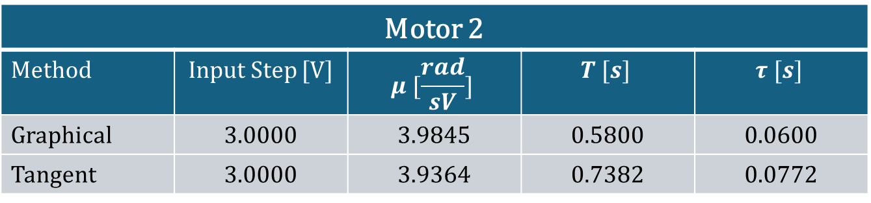
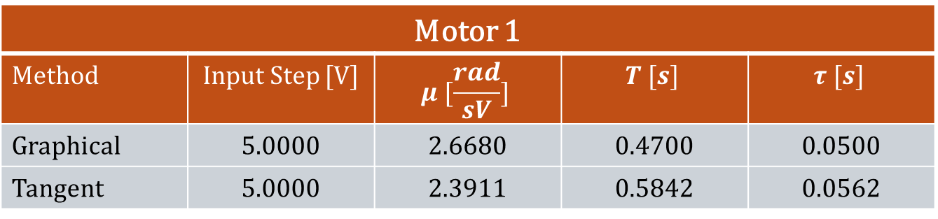
Final Comparison
Motor 1
Method | Input Step [V] | $$μ [\frac{rad}{sV}]$$ | $$T [s]$$ | $$τ [s]$$
Graphical | 5.0000 | 2.6680 | 0.4700 | 0.0500
Tangent | 5.0000 | 2.3911 | 0.5842 | 0.0562
Motor 2
Method | Input Step [V] | $$μ [\frac{rad}{sV}]$$ | $$T [s]$$ | $$τ [s]$$
Graphical | 3.0000 | 3.9845 | 0.5800 | 0.0600
Tangent | 3.0000 | 3.9364 | 0.7382 | 0.0772

Slide 15
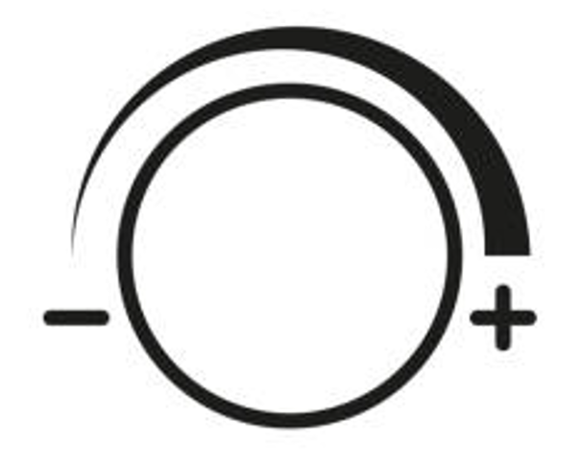
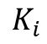
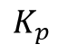
PI Controller Design
First Rough
Approach
Second Refined Approach
?
$$K_{p}$$
Ziegler-Nichols method based on open-loop response
Manual Tuning based on Matlab Simulations
?
$$K_{i}$$
Results in a too aggressive response
PI gains adequately modified to achieve a tradeoff between smoother/faster dynamics
Results in a too aggressive response

Slide 16
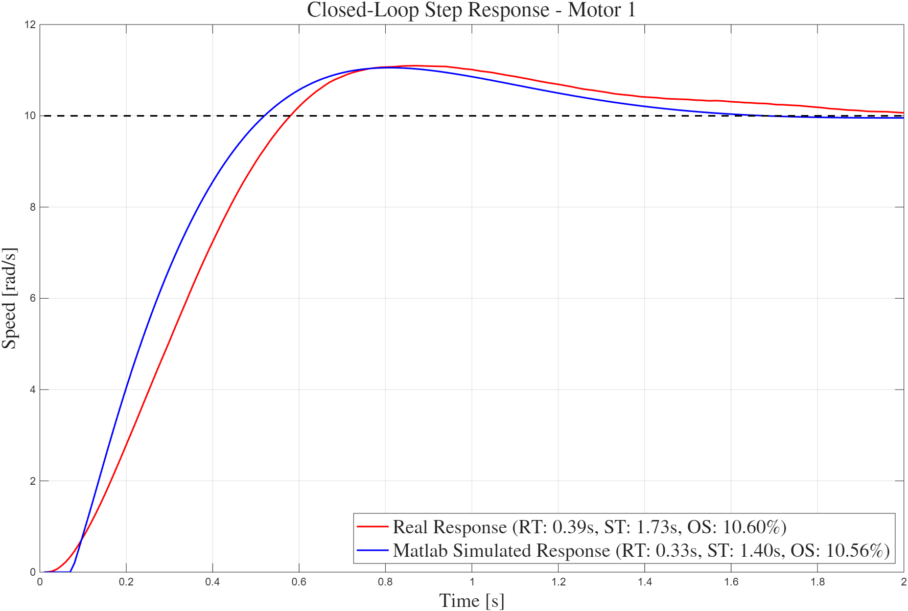
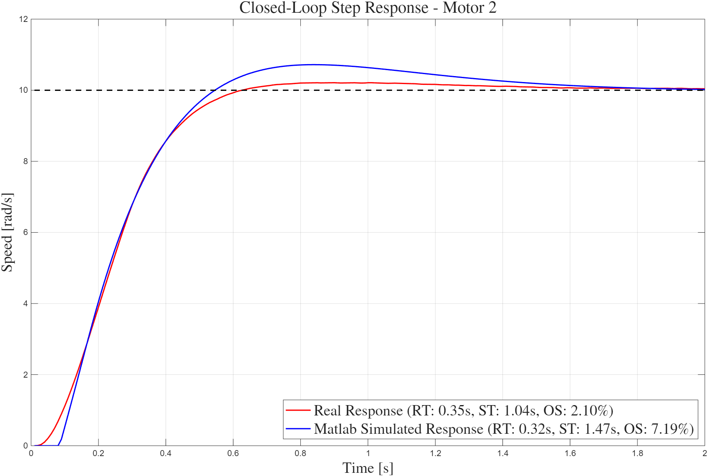

PI Controller Design - Results
PI tuned following Matlab ideal response
Speed Reference of $10 rad/s$

Slide 17
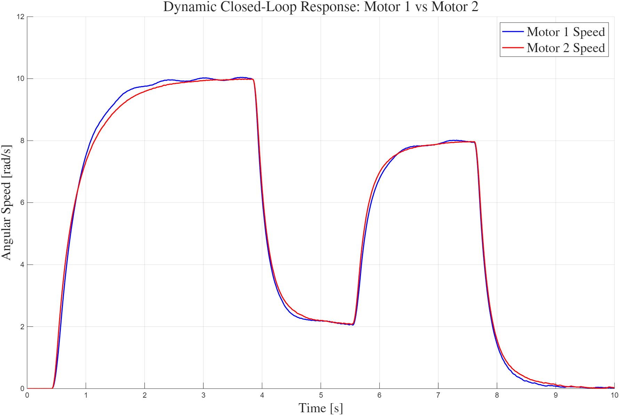
Combined Cross Validation
Individually each motor performs well…
We performed several tests with dynamic reference speeds
But they need to work together!
Slightly modified PI gains to achieve close dynamics
So, what about their combined responses?
Satisfactory results, but we were not done yet

Slide 18
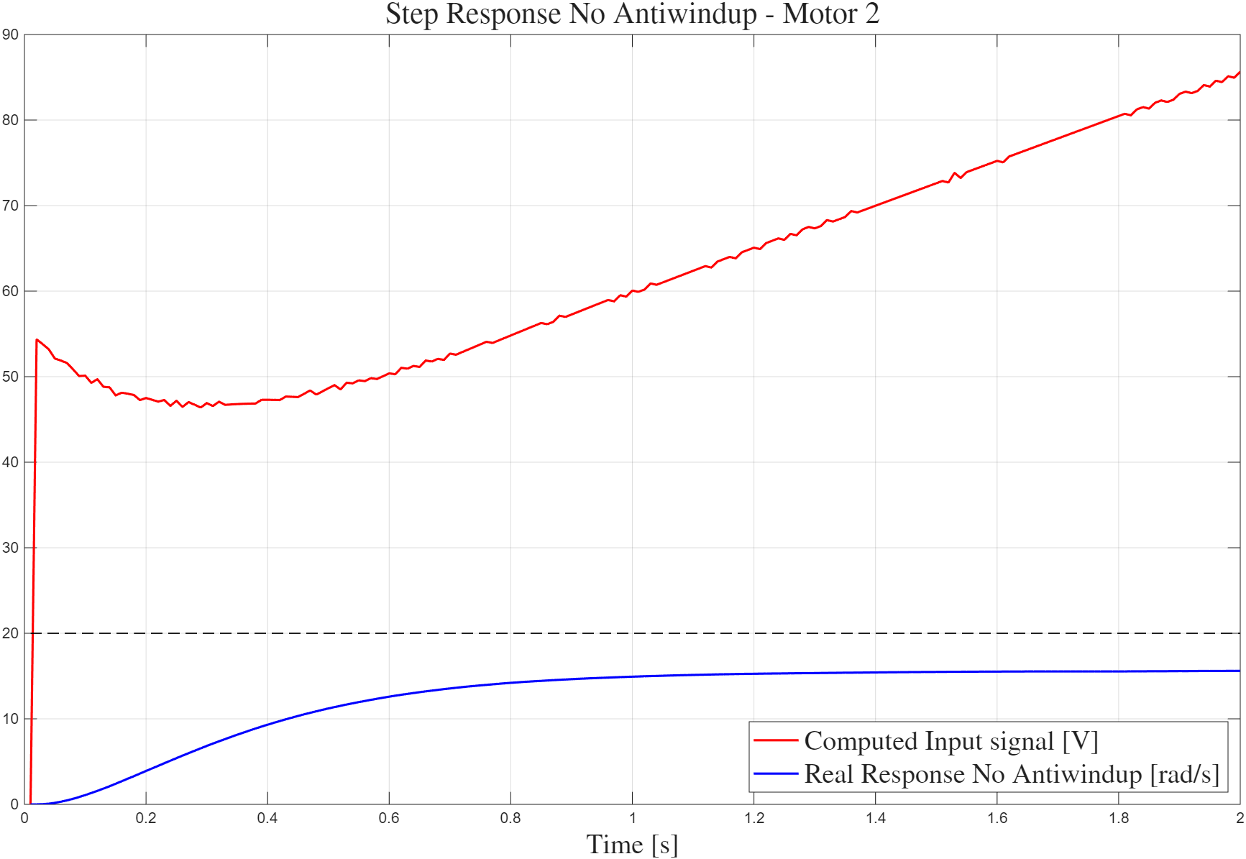

Windup Problem
A problem arose when we ran the code the first time
This results in…
Similar problem if motors were not powered on!
Input computed by the STM32 with
unreachable reference of $20 rad/s$

Slide 19
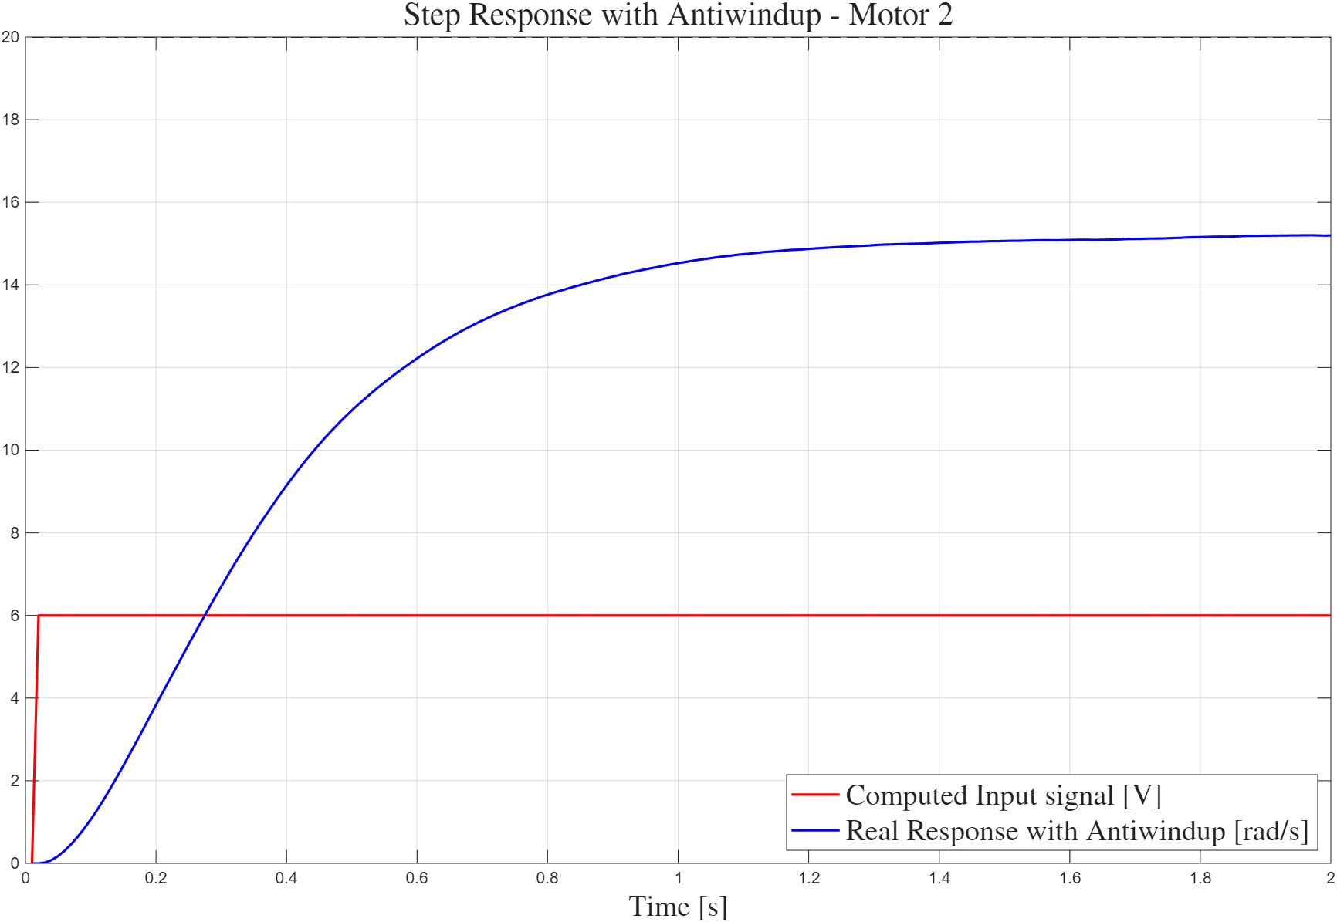

Anti-Windup Design
The solution is to implement an Anti-Windup
Clamps the integral error to match physical motor limits
Useful either when the motors are not powered on or when the reference is unreachable
Input computed by the STM32 with
unreachable reference of $20 rad/s$

Slide 20

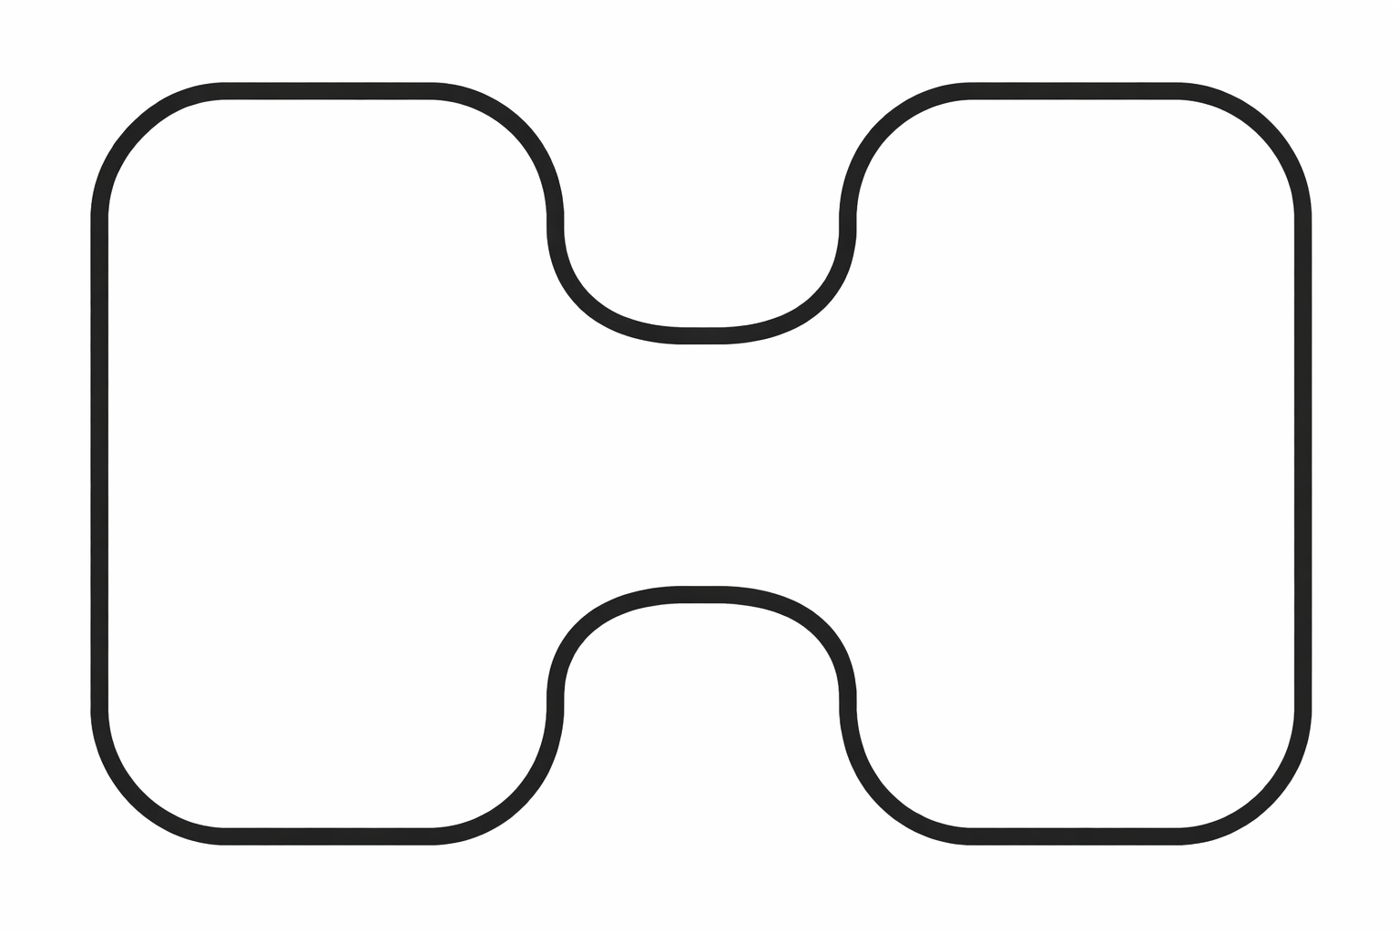
LABORATORY 4
Objective
Follow the line and achieve the fastest lap time.
Circuit A: Bullet
Circuit B: Hourglass
Notes:
Objective: follow the line and get the fastest lap speed! We have created the bilding blocks.
, two different tracks, first approach, just see if it was on the left turn left, if it was on the right turn right.

Slide 21
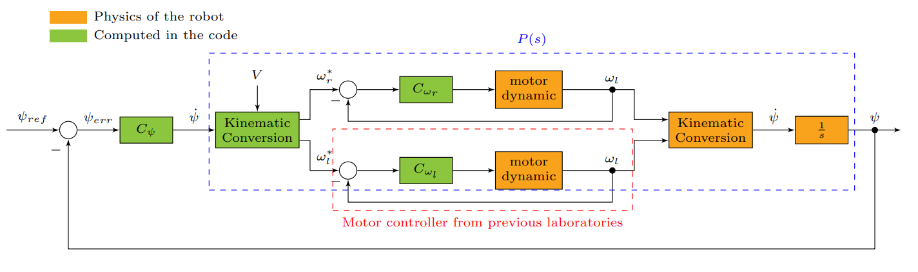
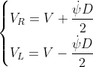

Controller Architecture
Calculating $ψ_{err}$
Kinematic Conversion
Computed as a weighted mean of the photodiode readings.

Slide 22
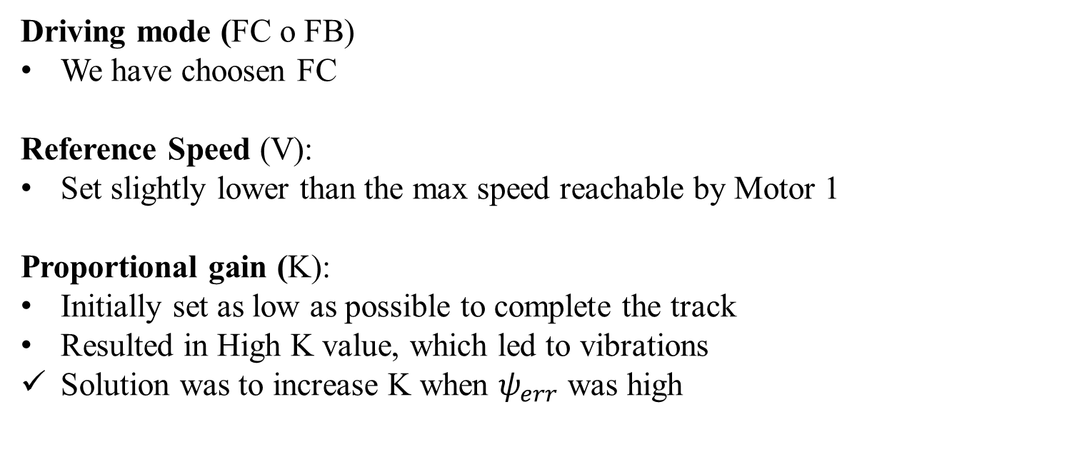
Tuning Parameters
Driving mode (FC o FB)
We have choosen FC
Reference Speed (V):
Set slightly lower than the max speed reachable by Motor 1
Proportional gain (K):
Initially set as low as possible to complete the track
Resulted in High K value, which led to vibrations
Solution was to increase K when $ψ_{err}$was high

Slide 23
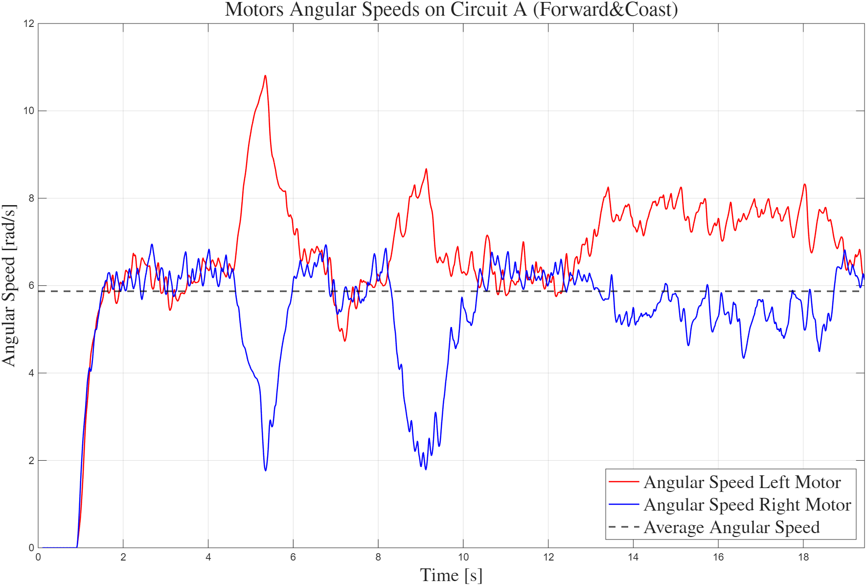
Circuit A: Bullet
Lap Time [s] | Avg. Angular Speed [rad/s] | Avg. Linear Velocity [m/s] | Estimated Distance [m]
19.38 | 5.87 | 0.20 | 3.87

Slide 24
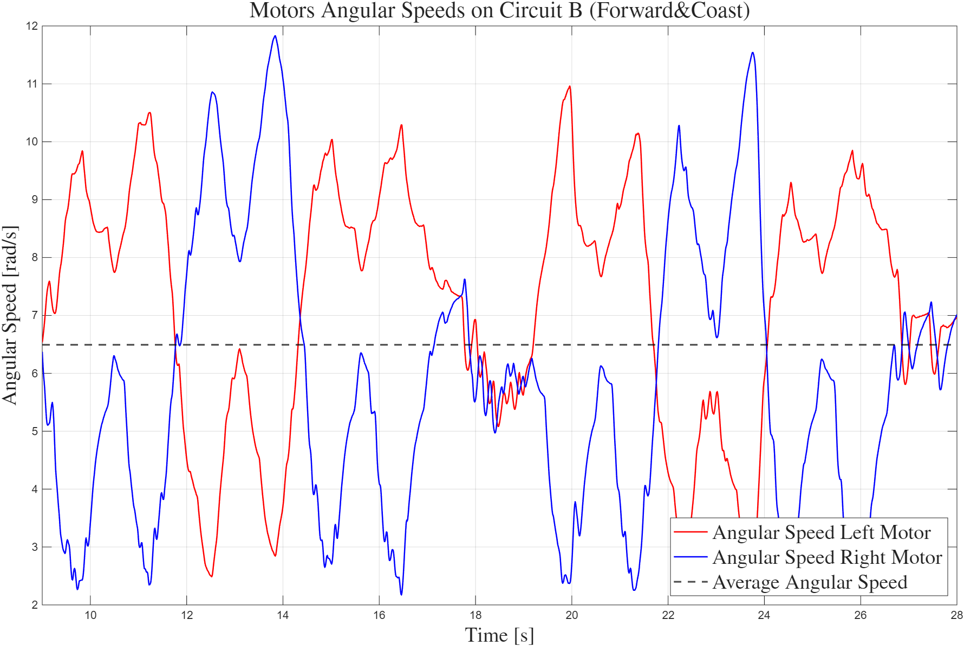
Circuit B: Hourglass
Lap Time [s] | Avg. Angular Speed [rad/s] | Avg. Linear Velocity [m/s] | Estimated Distance [m]
22.07 | 6.49 | 0.22 | 4.87

Slide 25
LABORATORY 5
Objective
Conversion to FreeRTOS
Redesign of sequential algorithm into independent tasks:
Line Task: handles line detection
Control Task: executes vehicle control logic
Communication Task: manages data exchange
Periodic execution is handled through osDelayUntil(10) → ensures no jitter

Slide 26
Task Managment
Queue
Get
Put
lineTask
controlTask
communicationTask
Sensor data
Telemetry data
(global variable)
Release
Acquire
Ensure synchronization with a Sempahore
Prevent
concurrent access with a Mutex

Slide 27
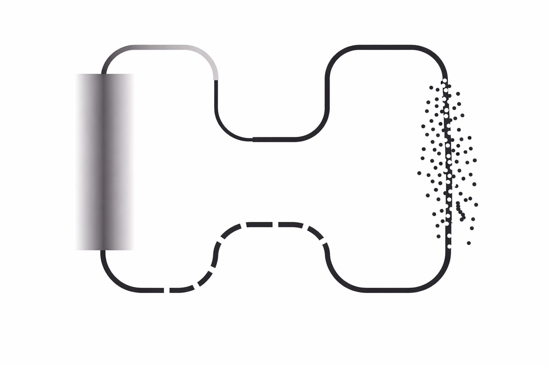
Noisy Track
Problem: TurtleBot successfully followed the line on all section, but fails on the gray line.
Proposed solution: Implement a behaviour based on prior knowledge of the circuit layout.

Slide 28
Following an Invisible Line
Line
Lost
Turn
Right
Control Parameters:
Rotation trigger condition
Rotation Magnitude
Line
Detected
■ Ideal
■ Late or Under Rotation
■ Early or Over Rotation

Slide 29
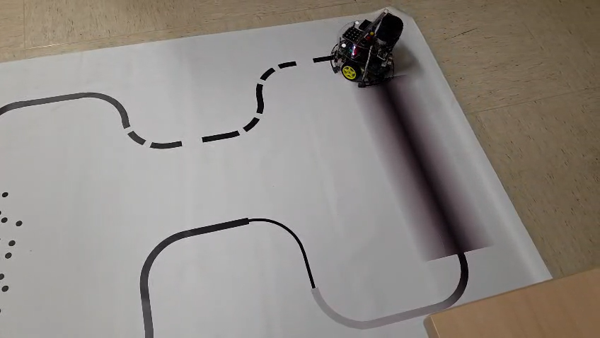
Final Result

